Slide 1
Airline Sentiment Analysis
By Victoria Porter, Will Holbrook, Laura Cope, Lauren Cooper and Joel Wolinsky
Notes:
Welcome to team five’s presentation on tweet sentiment analysis.

Slide 2
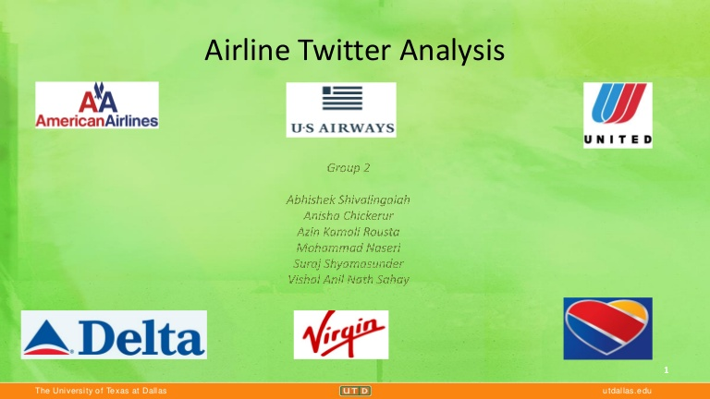
Agenda
Exploratory Analysis
Preparing the Dataset
Modelling Experiments
Performance Analysis
The Final Model
Final Model Insights
Teamwork
Learning Outcomes
Questions
Notes:
We’ll start off with how we explored and prepared the dataset, the models we used to classify sentiment and the insights we learnt in the process.
Exploratory analysis - 1-2min
Preparing the dataset and business outcomes 2min
30s per model 1min30
30s final model
Key Predictors - 30s
Challenges - 30s
Sentiment Conclusion - 45s-1min
Technical next Steps - 30s
Teamwork and Learning outcomes - 1min30

Slide 3
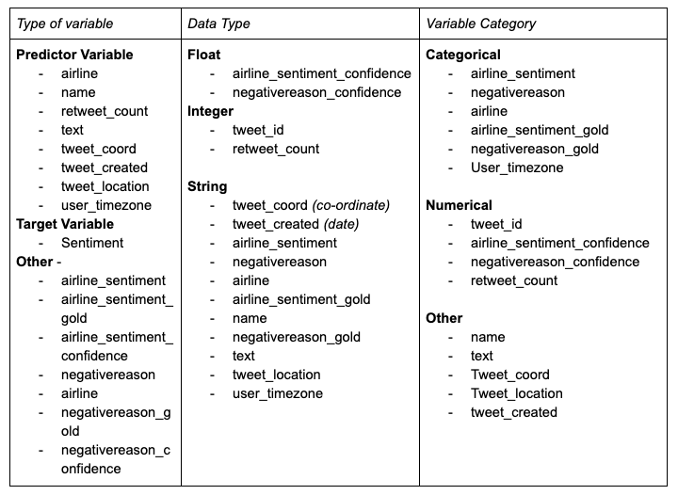
Exploratory Analysis
Variable identification
Notes:
Introduce the dataset
So the tweet dataset we were given consisted of roughly 14,000 tweets addressed to multiple airliners over the course of a week in early 2015.
We started off with variable identification, indicated any unusual var that may be less useful (airline_sentiment_gold & negativereason_gold) and had missing values-- (location based attributes)
tweet_coord, tweet_location & user_timezone

Slide 4
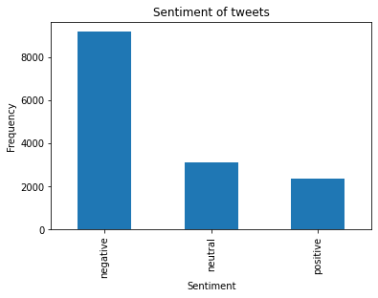
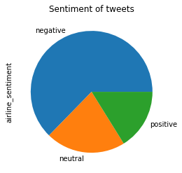
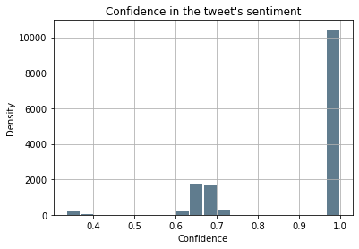
Sentiment
Notes:
The general sentiment of the tweets - negative than positive or neutral
And with the confidence of this sentiment being mostly around 100%
but with a small cluster between 60 and 70

Slide 5
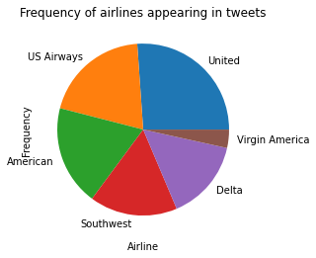
Airlines
Notes:
There were a similar number tweets found for each airline apart from Virgin America

Slide 6
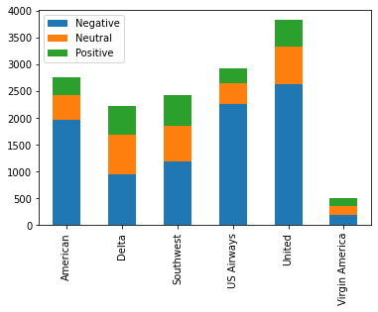
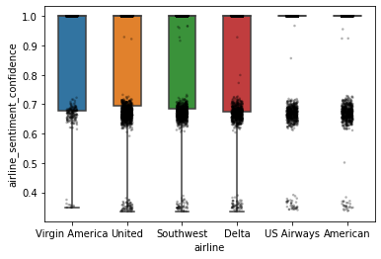
→ Airlines and Sentiment, and respective Confidence
Notes:
There was also a similar proportion of tweet sentiment between the airlines
majority negative and slightly more neutral than positive
Interestingly US airways and American had a significantly higher confidence in the sentiment rating
Could influence our models later

Slide 7
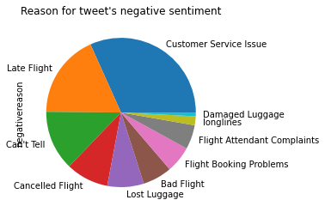
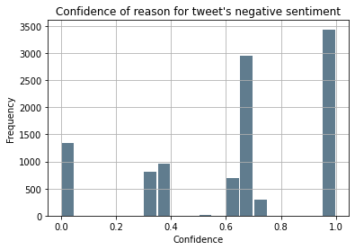
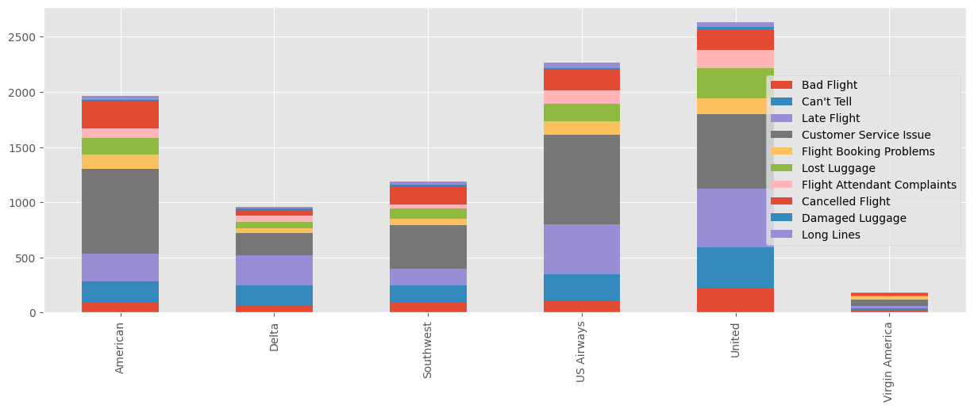
Reason for negative sentiment
Notes:
Customer service was the most common negative reason, followed by late flight and can’t tell
Again similar proportions across all airliners
However the confidence was much more varied for this
Indicating that it’s harder classify reason than sentiment

Slide 8
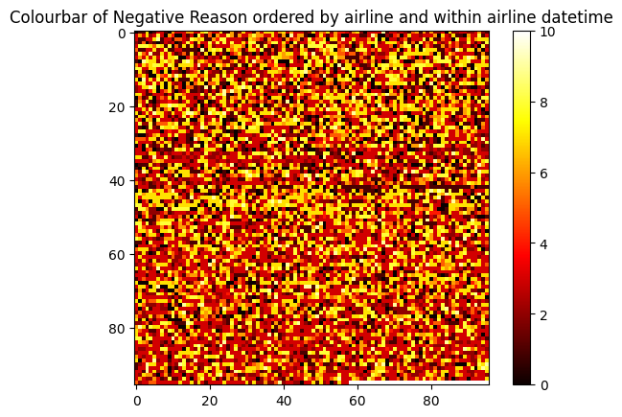
Notes:
CUT?
Small clusters of tweets made to the same airline at a similar time were commonly found to have the same negative reason as shown on the colormap with multiple cells horizontally of the same colour

Slide 9
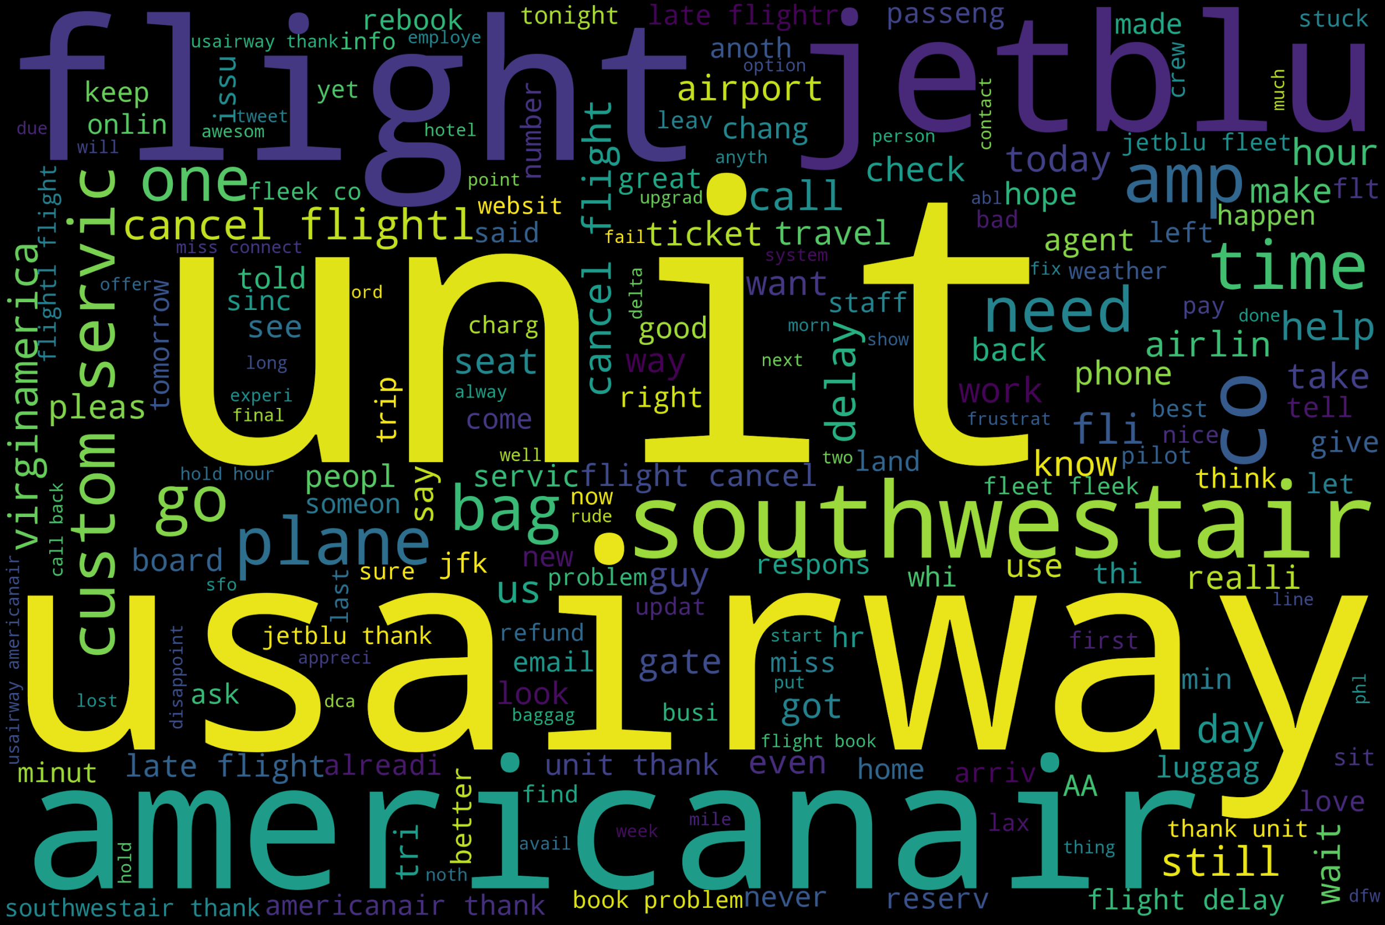
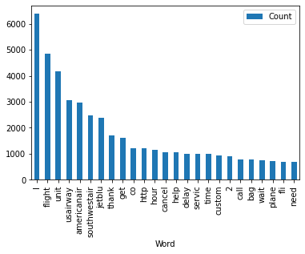
Text
Notes:
CUT?
We analysed the most common words within the all tweets - most common was
The most common words across all tweets were ‘I’, ‘flight’ and ‘unit’ (in place of a currency symbol) followed by the names of airliners

Slide 10
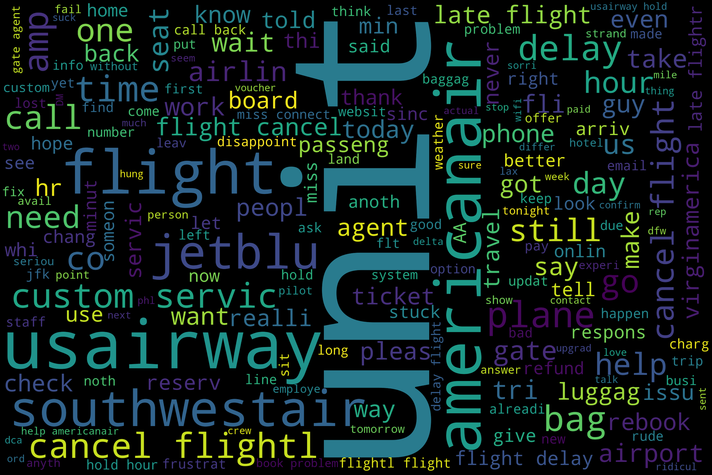
→ Text and Sentiment
Negative tweets
Notes:
Text was most important factor in determining the tweet sentiment, with words such as ‘cancel’, ‘delay’, ‘customer service’, ‘time’, ‘wait’, ‘late’ indicating a negative sentiment.
The same was also true of neutral and positive tweets, but the frequency of common words was much reduced - due to the higher volume of negative tweets
That being said positive tweets were very likely to feature ‘thank’ - which boosted the models’ ability to classify positive over neutral
However there was a lot of overlap between positive and neutral common words - made it harder to classify the sentiment
The most common key words in neutral tweets included: thank, need, please, help, DM, change, time
Whereas positive tweets - love, good, much, best came up

Slide 11
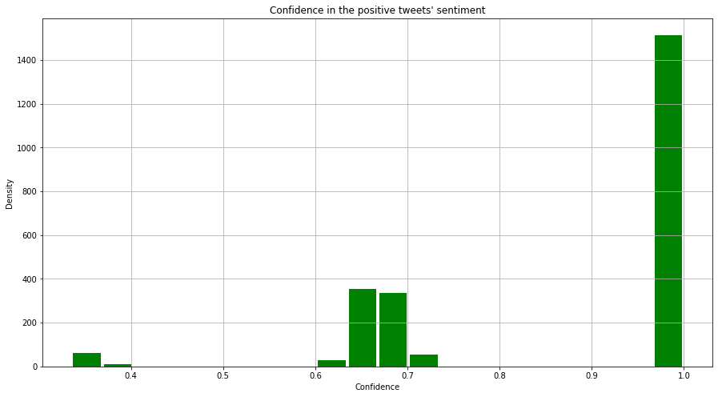
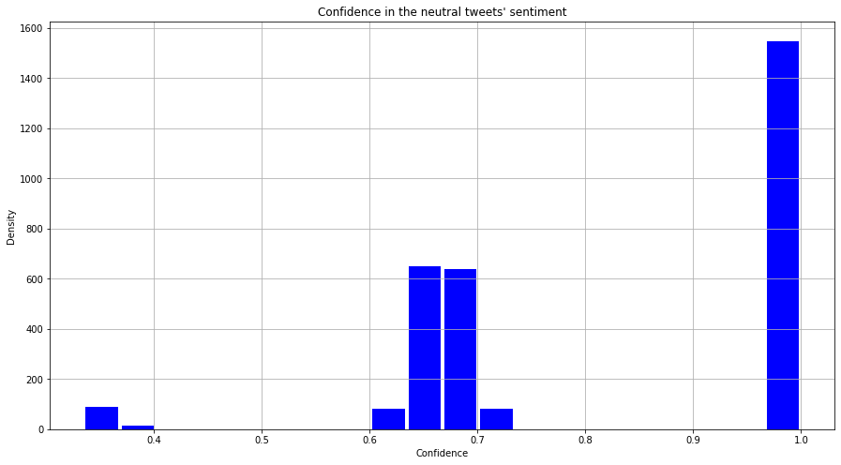
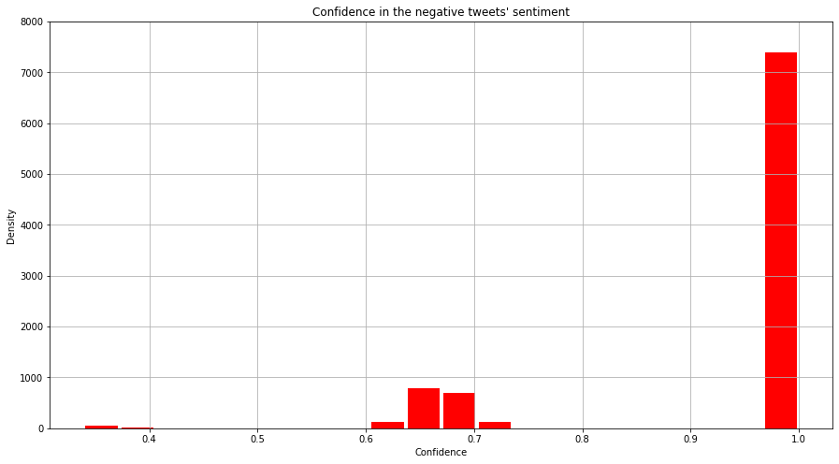
Sentiment Confidence
Positive
Neutral
Negative
Notes:
This impacted the sentiment confidence, with negative tweets being the easiest to classify, followed by positive then neutral

Slide 12
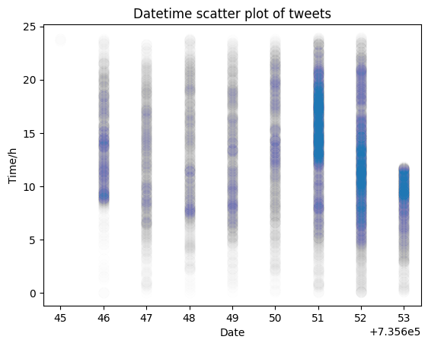
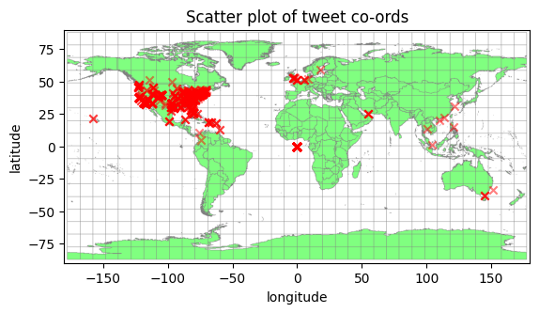
Creation datetime, Co-ords
Notes:
Analysing the creation date indicated spikes in the tweets over the weekend and Monday and pockets of high volume throughout the daytime
Analysis of the location based attributes indicates the concentration of tweets from the US

Slide 13
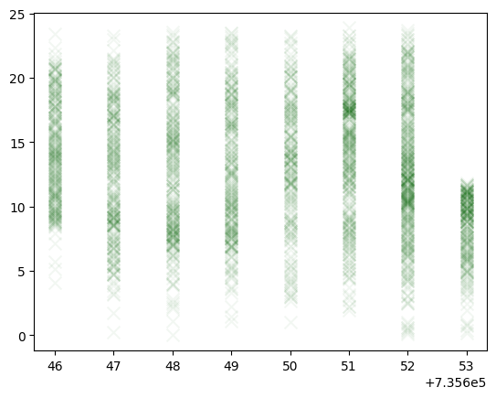
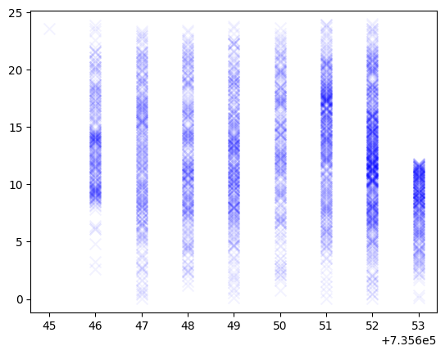
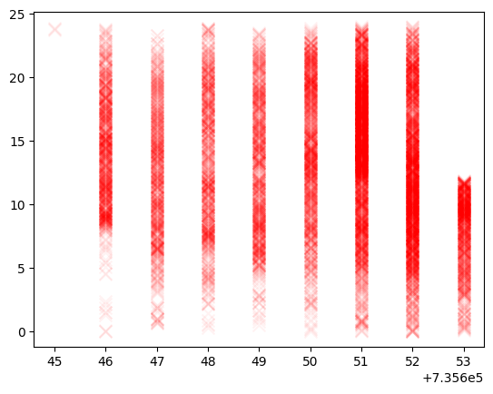
→ Creation datetime and Sentiment
Positive
Neutral
Negative
Notes:
Generally the dataset had pockets of high tweet volume during the day with the standard sentiment distribution and tailing off towards early morning,
These pockets had a typical distribution with more negative than positive or neutral
Generally the distribution of sentiment was the same over all times with only some anomalies such as significantly more positives on Monday afternoon and significantly more negatives on Saturday morning

Slide 14
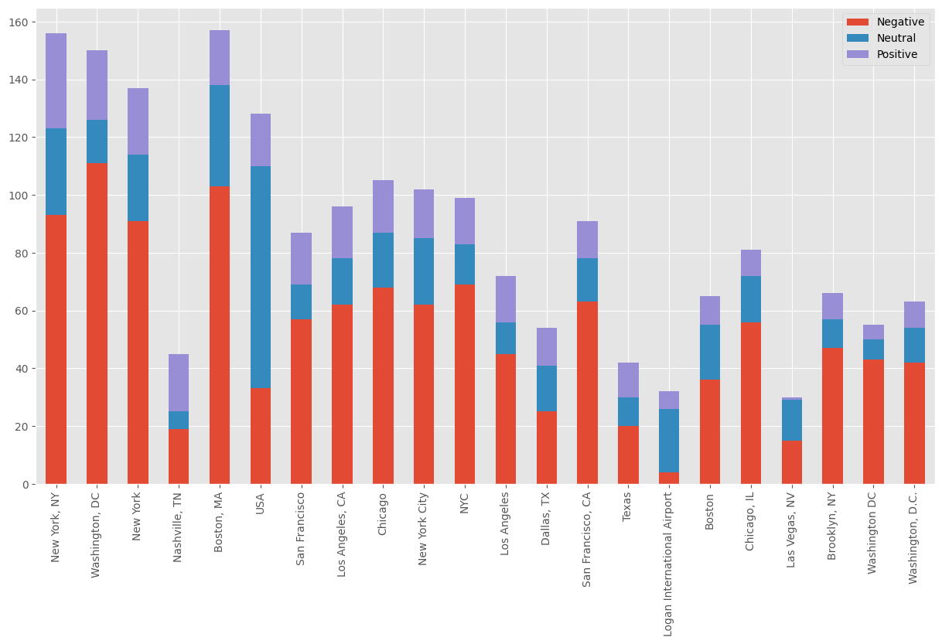
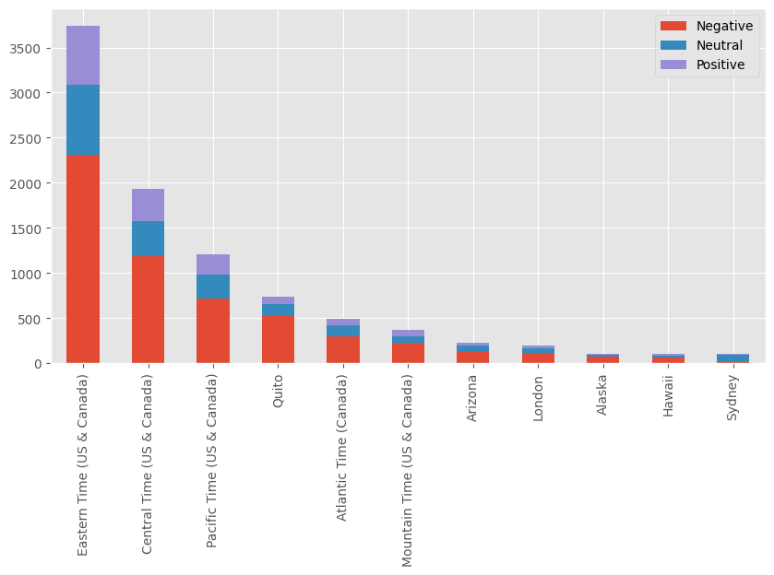
→ Location and Sentiment , Timezone and Sentiment
Notes:
Further analysis into how the sentiment varied with location indicated the sentiment ratio stayed
The sentiment ratio was pretty much the same over all locations
There were slight variances the sentiment proportional across non-US countries, such as more neutral than negative tweets in Australia, but there was enough data to draw any real conclusions

Slide 15
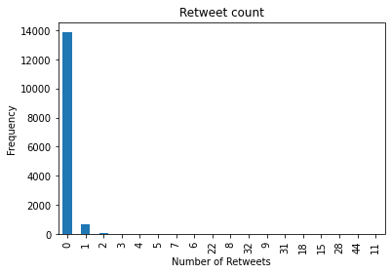
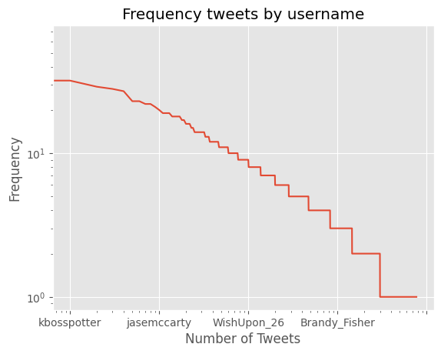
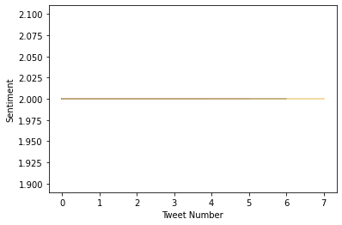
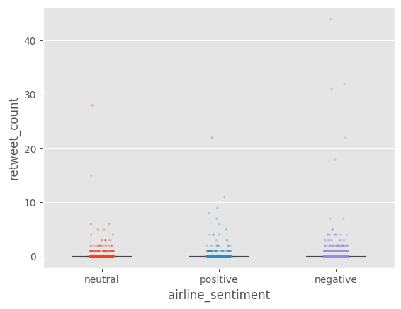
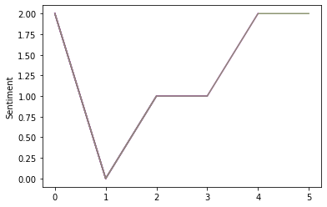
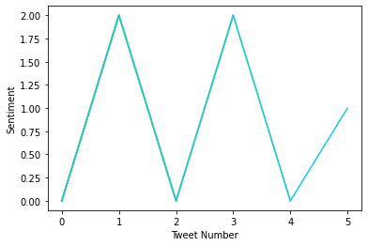
Name
Retweet Count
Retweet Count
Notes:
Retweet count was similar across all sentiments, didn’t provide much insight
s, with many having a constant negative sentiment (top) or progressively get more negative (middle), some fluctuating
between negative and positive perhaps indicating different problems being resolved over multiple flights
We also investigated the sentiment progression where users tweeted multiple time However due to the individual variation, we weren’t able to use to it to help us classify sentiment

Slide 16
Preparing the Dataset
Techniques used:
Tokenization
Removing stops words
Stemming & Lemmatizing
Removing Airline_sentiment_confidence < 0.6
Before - ‘@VirginAmerica it was amazing, and arrived an hour early. You're too good to me.’
After - ‘virginamerica amaz arriv hour earli you good’
Notes:
Lessons learnt from last time - analyse data before using it, preprocess data
Reduced the data 238 rows

Slide 17
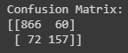
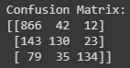
Baseline Model: Naïve Bayes
Model Type | Model Name | Training Time/s | Testing Time/s | Accuracy | RAM Used/GB
Baseline | Naïve Bayes | 2.186 | 45.665 | 0.7668 | 0.16
Experiment
-ve and +ve
-ve, neu and +ve
Notes:
Victoria: We decided to use Naïve Bayes as our baseline model and as you can see, it’s performance is a bit of a mixed bag. On one hand, it’s computation is quite fast and it uses a relatively small portion of RAM to process over 14,500 tweets, making it useful when the dataset grows larger.
Contrastly, the accuracy is low when compared to other more complex models out there.
If you look at the confusion matrices at the bottom the one on the left represents classification after tweets with neutral sentiment have been removed whilst the one on the right represents classification where neutral tweets are included.
During the exploratory analysis phase, Laura identified the most common words associated with each sentiment. Based on the results from this, we discovered that tweets with neutral sentiment mostly consisted of words that were also common in positive or negative tweets, such as “flight” or the name of a particular airline.
This forms our hypothesis as to why neutral tweets were misclassified the most and an interesting result from the experiment is that the accuracy of this classifier increases to 0.88 when only positive and negative sentiments are considered.

Slide 18
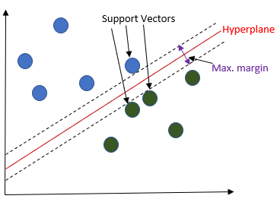
Non-Neural Model: Support Vector Machine (SVM)
Model Type | Model Name | Training Time/s | Testing Time/s | Accuracy | RAM Used/GB
Non-Neural | SVM | 234.618 | 9.553 | 0.7766 | 0.47 GB
Notes:
Will: For our Non-Neural Classifier I decided to look at SVM, It’s performance was only marginally better than naive Bayes however the accuracy can most likely be improved through hyper parameter tuning if you were to do further development in the future
The SVM works by using a count vectorizer to convert each piece of text into a vector with each dimension being a 1 or a 0 and the training the classifier on vectors

Slide 19

Pretrained Model: MonkeyLearn Sentiment Analysis
MonkeyLearn was one of the few fully off-the-shelf pretrained sentiment analysis models available for free.
Benefits include a simple implementation, a quick runtime with no training needed.
Drawbacks include little available information on the model itself: it is very much a black box. No details available on the model or training data. This could limit the model’s ability to understand tweets as opposed for formal language
Only 300 free queries allowed per month limited how much we could test the model

Slide 20
MonkeyLearn Results
Mid-level accuracy, possibly overfit to training data or trained or formal English language writing. This teaches us that the training data used is very important, and some pre-trained sentiment analysis models may not be suitable for informal language.
The model worked significantly better on the raw tweets as opposed to the cleaned data set. The confidence score on the raw data was also much higher.
Next steps would involve a paid subscription which would likely come with more detail on the model and training data itself, and the ability to test more data.
Test Data Used (300 tweets each) | Accuracy | Average Confidence
Cleaned | 0.563 | 0.7092
Raw | 0.780 | 0.7740

Slide 21
The Final Model
Model Type | Model Name | Training Time/s | Testing Time/s | Accuracy
Baseline | Naïve Bayes | 2.186 | 45.665 | 0.7668
Non-Neural | SVM | 234.618 | 9.553 | 0.7766
Pre-trained | MonkeyLearn Sentiment Analysis | N/A | 150.650 | 0.7800
Notes:
Will: The final model we chose was SVM as it had the second highest accuracy but the lowest testing time out of the 3 models with the pre-trained model only able to test 300 tweets at a time which would make it more effective to use in business for live processing of tweets
The negatives of SVM compared to the other models is that is has a much higher training time so it will be slower to develop and harder to do hyperparameter tuning on in the future when trying to optimize the model
Another reason for not choosing the Pre-trained model is that it cannot be trained on more data to improve the accuracy as it probably has been pre trained on other types of text whereas with SVM if more data were to be collected you can most likely improve the model especially with more positive and neutral tweets to balance the dataset

Slide 22
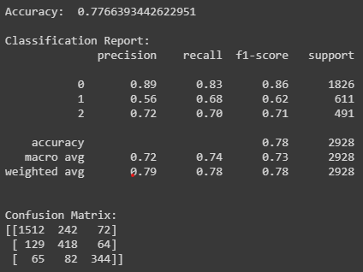
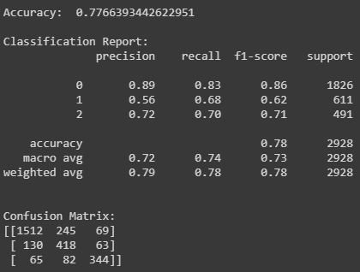
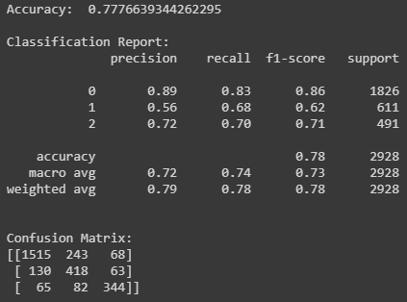

Key Predictors
Tweet Time
Just Tweet Text
With TimeZone
With retweet
Notes:
WIll: When looking at key predictors for the model the best key predictor is the text itself however only certain words are significant in prediction, for instance, stop words such as “so” or “the” have no real impact on sentiment whereas words like “cancel” are significant predictors for sentiment
After text, I considered looking at the meta-data of the tweets to see if it could improve the accuracy of the model
Including the timezone that the tweets were posted in allowed 3 more tweets to be accurately predicted whereas when I included the number of retweets or the time the tweet was sent it didn’t help the classification at all and it meant there needed to be more pre-processing of the data to convert from the given data to integers which the model could be trained on which increased to overall training time
I also attempted to only train the model with high sentiment confidence tweets however I could only get it to execute if it had a high stopping tolerance which meant it had a low accuracy so this didn’t help as a key predictor
Interestingly if you test and train on only high sentiment confidence tweets this significantly increases the accuracy however I believe this is only because those tweets are easier to predict not that it made the model significantly better

Slide 23
Challenges
Choosing which columns of the dataset to feed into the model and assessing how much of an impact they had (feature importance)
Knowing how much to clean and prepare the data for processing
Pre-Trained models for sentiment analysis are not easily accessible for free experimentation and keep their parameters hidden
A problem beyond our control left us without a neural model, which we initially predicted to be our best performing model
Our ‘baseline’ model (Naive Bayes) performed similarly to our other models but in a shorter time, meaning that these more complicated models may not actually be better

Slide 24
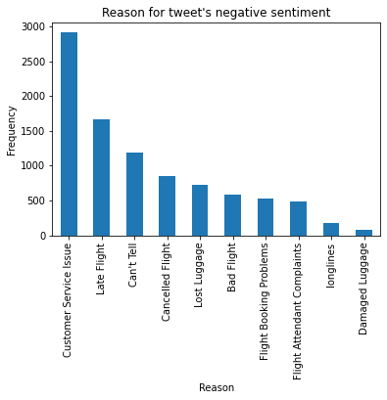
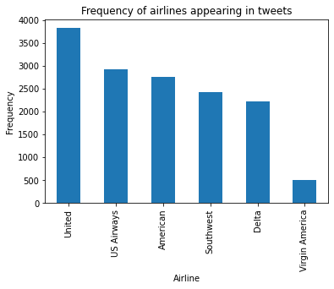
Sentiment Conclusion
Notes:
Laura spoke earlier on the weighting of positive, negative and neutral sentiment towards each airline and identified that the relative sentiment proportions for each airline were fairly similar with Southwest having the most positive tweets and United having the most negative tweets.
As I mentioned earlier, we identified that the most common words found in neutral tweets also tended to have a high ranking in negative tweets. These were words like ‘flight’ which has a neutral meaning but obviously given the context of the task this particular word was almost guaranteed to appear across all sentiments.
Will mentioned that one of our best key predictors is the tweet text itself so as a future investigation it would be interesting to explore this further to see if there is a way to identify words with a neutral meaning and permit the models to ignore them without diminishing the integrity of the data.
You can see in the graph on the right that there are a range of reasons for negative sentiment with customer service issues being the most prominent so Laura and Joel are going to take us through the possible ways that the airlines can use this information to improve their services.

Slide 25
Technical Next Steps
Building a cloud model that classifies using our findings
Balance and expand dataset
Notes:
Technical next steps: building a cloud model that classifies using our findings
If negative sentiment is very confident maybe get someone to reply to tweet or generate an automatic response
To increase the accuracy of our models especially with classifying positive and neutral tweets we would need to balance and expand the dataset, we researched into augmenting the tweets by replacing words with synonyms however this is difficult simply due to the complexity of language. Not every word has a synonym and changing one word will completely change the original authors context and intentions.
So instead a more efficient approach we concluded would be to just collect more tweets
Balance out the dataset + expanding it
Talk about -ve of augmentation in NLP

Slide 26
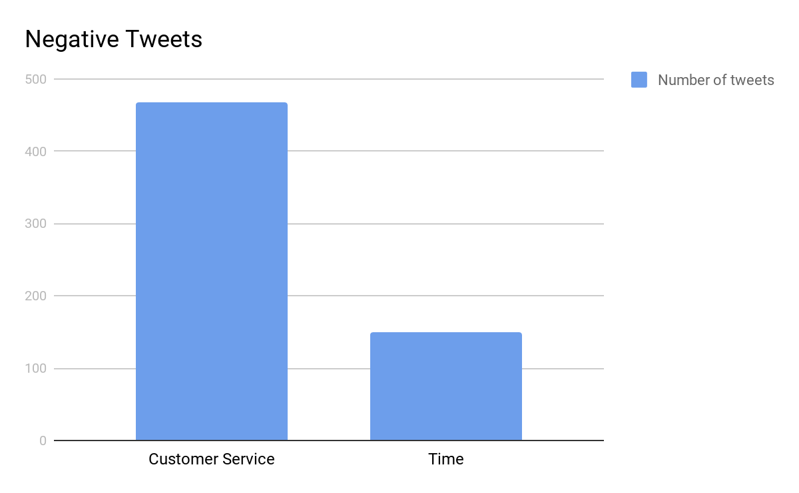
Business Next Steps
1035 of the tweet were related to Customer service
22% of those tweets mentioned time
Quite a simple problem to fix
Notes:
Easiest way to get info from the data was Just by looking into the most popular words in tweets
Quite a simple problem to fix, get more staff
Might not seem like a lot but thats over 100 people a day
The point is more that its very easy to find common problems
So if the model was implemented in realtime, there might be more short term issues the could fix

Slide 27
Teamwork
Video calls 1-2 times a week and messaging in between helped delegate work and check up on progress.
We split up to explore different areas of the project, sharing our results in Google Drive using Google Colab for our code.
A setback towards the end of the project meant we did not have a completed Neural Network solution, but we were able to regroup quickly and reevaluate our approach to the project.
Splitting up the project into stages and using an agile methodology allowed for smooth re-planning and adaptation.

Slide 28
Learning Outcomes
Data exploration is key to good results
Introduction to NLP
Learning Python
There is no one size fits all model
Impact of cleaning a dataset
ML Evaluation Metrics
Power of visualisation
Notes:
Victoria: You can see our team’s learning outcomes on the slide, a lot of it was learning new concepts that many of us had little to no prior experience with such as Natural Language Processing as well as implementing a range of neural and non-neural techniques.
One of the most significant lessons we learnt is that the quality of the model input has a huge effect on the quality of the output.
Sometimes it’s easy to skip the manual and jump straight into the code and we think that this task certainly highlighted the importance of exploring the data first as we found that a lot of the conclusions we drew during the exploration stage were key in explaining the output of the models.

Slide 29
Questions?

